Slide 1

Atliq Hardwares
Consumer Goods Domain
Ad – hoc Insights
Presented by: Harshali Sonawane

Slide 2

Agenda
Introduction
Project Overview ( Project Objective and about database)
Ad-hoc Requests , Queried Results , insights and Visualization

Slide 3
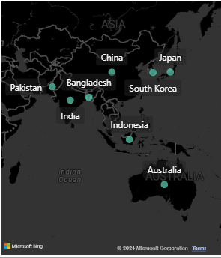
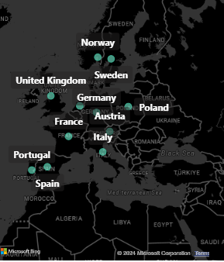
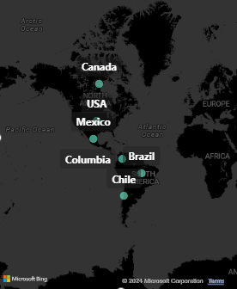
Introduction
Atliq Hardware is one of the leading computer hardware producers in India and has also expanded its operations to other countries.
. It manufactures products under three major divisions: 'P & A' (Peripherals and Accessories), 'N & S' (Network and Storage), and 'PC' (Personal Computer).
The market presence of Atliq Hardware's extends across 26 countries worldwide.

Slide 4
Project Overview
Project Objective :
Collaborate with the management team of Atliq Hardware's to gain insights into the company's product sales, enabling quick and intelligent data-informed decisions to scale the business.
About Database :
Atliq Hardware provides a dataset that contains four fact tables and two dimensional tables, namely:
dim_customer: contains customer-related data
dim_product: contains product-related data
fact_gross_price: contains gross price information for each product
fact_manufacturing_cost: contains the cost incurred in the production of each product
fact_sales_monthly: contains monthly sales data for each product
fact_pre_invoice_deductions: contains pre-invoice deductions information for each product.

Slide 5



Ad-hoc Requests , Queried Results , insights and Visualization
The tools used for data analysis are:
MySQL for Data Analysis.
Power BI for Data Visualization.
Microsoft Power Point For Presentation

Slide 6

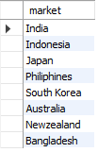
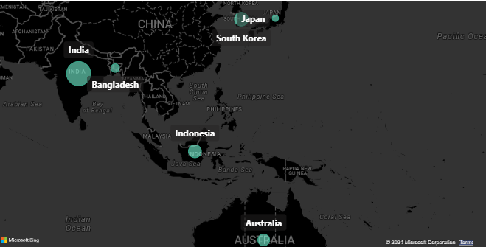
Request 1: Provide the list of market in which customer “Atliq Exclusive “ operates its business in APAC Region
Sql Query :
Sql Query Output :
Insights : In the Asia-Pacific region, our 'Atliq Exclusive' store has been established in 8 countries, of which India is the leading market in terms of gross sales .

Slide 7
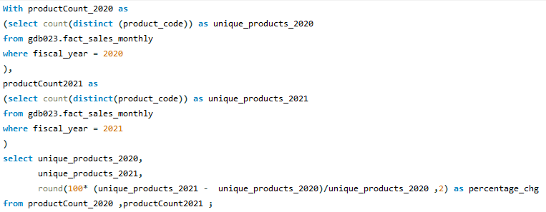
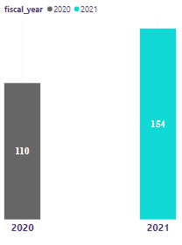

Request .2: What is the percentage of unique product increase in 2021 vs 2020?
Sql Query :
40% product count increses in 2021
Output :
Insights : We observed a 40% increase in new product launches from 2020 to 2021, indicating positive growth performance for Atliq Hardware..

Slide 8
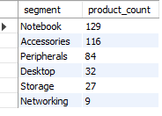

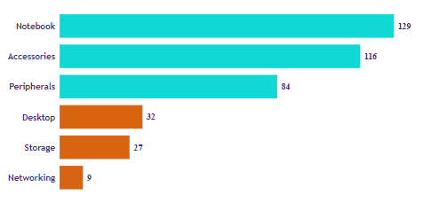
Request .3: Provide a report with all the unique product counts for each segment and sort them in descending order of product counts.
SQL Query :
Query Output :
Insights : Atliq Hardware produces products in six unique segments, namely, Notebooks, Accessories, Peripherals, Desktops, Storage, and Networking. Out of these, Atliq produces a maximum of 129 unique products in the Notebook segment, while the Networking segment has fewer than nine products.

Slide 9
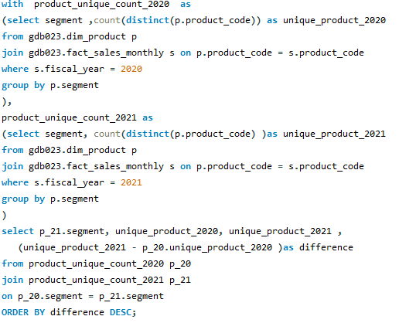
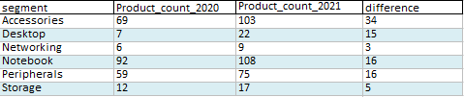
Request .4: Which segment had the most increase in unique products in 2021 vs 2020?
SQL Query :
Query Output :

Slide 10
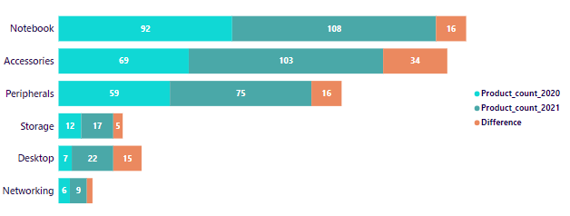
Insights:
From the analysis, we observe that Atliq Hardware introduced more new products to the market in fiscal year 2021 than in 2020.
Out of these, in the Accessories segment, Atliq produced 34 new products, which is more than in any other segment.
Both the Notebook and Peripherals segments each experienced an increment of 16 new products.
The product development team at Atliq Hardware demonstrated effective performance in the Desktop segment by increasing the number of unique products from 7 to 22.
Lastly, in Networking, Atliq introduced 3 new products in 2021.
3

Slide 11
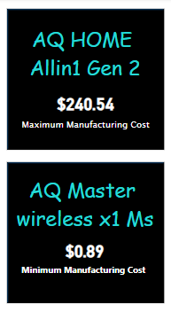
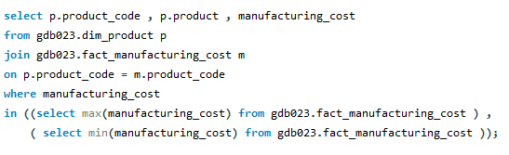

Request .5 Get the products that have the highest and lowest manufacturing costs?
SQL Query :
Query Output :
Insights: Out of all products produced by Atliq Hardware until fiscal year 2021, the AQ Home Allin 1 Gen 2 had the highest manufacturing cost at $240.54, while the AQ Master Wireless X1 MS had the lowest manufacturing cost at $0.89.

Slide 12
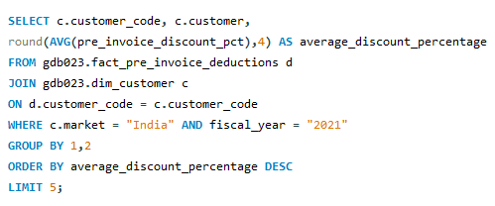
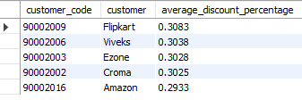
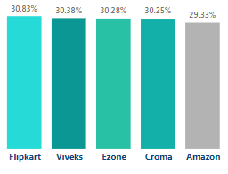
Request .6 Generate a report which contains the top 5 customers who received an average high pre_invoice_discount_pct for the fiscal year 2021 and in the Indian market
SQL Query :
Query Output :
Insights :
Insights from Flipkart, Viveks, Ezone , Croma, and Amazon reveal that these are the top five customers in India that received the highest discount percentage for Atliq Hardware products during the fiscal year 2021.

Slide 13
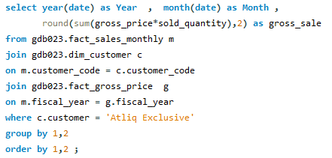
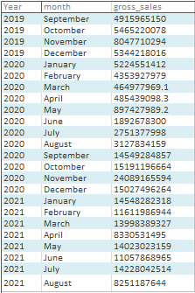
Request .7 Get the complete report of the Gross sales amount for the customer “AtliqExclusive” for each month. This analysis helps to get an idea of low and high-performing months and take strategic decisions.
SQL Query :
Query Output :

Slide 14
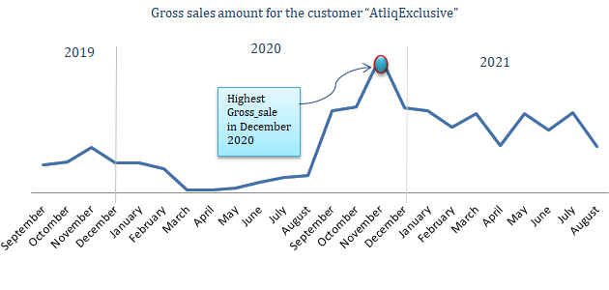
Insights :
At Insights For, an athletic exclusive store, the maximum sales were recorded in November 2020, amounting to $20.46 million.
While the lowest sale was recorded in March 2020, totaling $0.38 million.
The low sales from March to August 2020 were attributed to the Covid-19 pandemic, during which stores were shut down. Sales began to improve from September 2020 onwards.

Slide 15
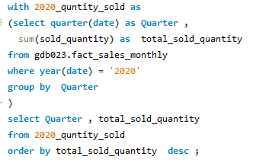

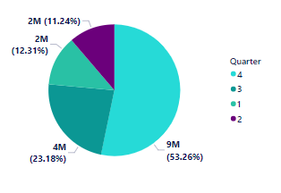
Request .8 In which quarter of 2020, got the maximum total_sold_quantity?
SQL Query :
Query Output :
Insights :
Atliq Harware sold the highest quantity of hardware in quarter 4 of the fiscal year 2020, which started in September 2019.
The lowest quantity was sold in quarter 2 of the fiscal year 2020.

Slide 16
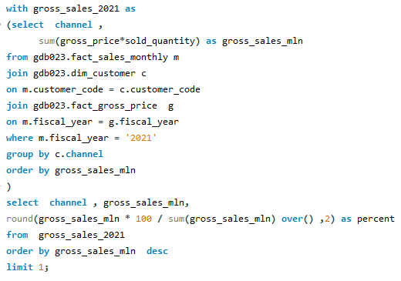
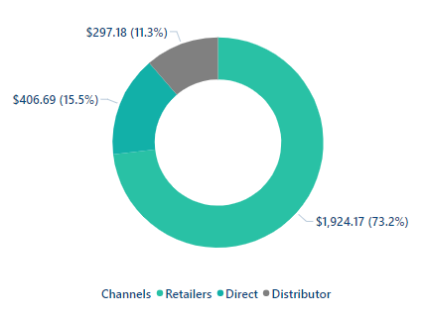

Request 9. Which channel helped to bring more gross sales in the fiscal year 2021and the percentage of contribution?
SQL Query :
Query Output :
Insights:
Among the three channels of athletic hardware, the retailer channel had the highest contribution, gathering 73.2% of the overall gross sales in the fiscal year 2021.
In contrast, the distributor channel had the lowest gross sales collection out of all the channels, at 11.3%.

Slide 17
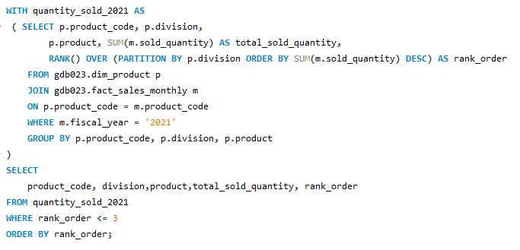
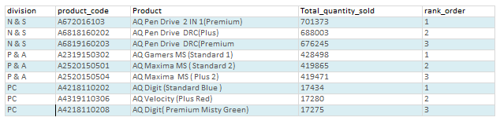
Request 10. Get the Top 3 products in each division that have a high total_sold_quantity in the fiscal_year 2021?
SQL Query :
Query Output :

Slide 18
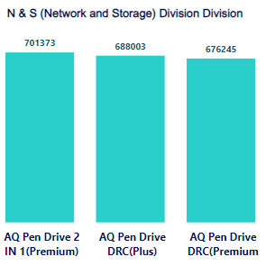
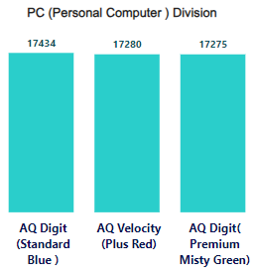
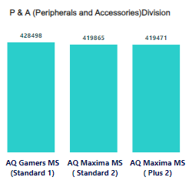
Insights :
In fiscal year 2020, Atliq Hardware produced different products under three divisions.
In that year, the highest quantity product sold in the Network and Storage division was the AQ Pen Drive 2 IN 1 (Premium), with approximately 0.70 million units sold.
The highest quantity product sold in the Peripherals and Accessories division was the AQ Digit (Standard Blue), with approximately 0.17 million units sold.
The highest quantity product sold in the Personal Computer division was the AQ Gamers MS (Standard 1), with approximately 0.42 million units sold.

